Slide 1


| Tech Management, SRI-B
CLAWS
CLASH OF THE
Ramaiah Institute of Technology
LockedIn AI
LockedIn AI is a proactive academic assistant that detects urgency and turns last-minute chaos into clear, actionable study plans in real time.
Shreyas G · Samarth C · Sailesh P

Slide 2
LockedIn AI
Problem Statement
Why this theme:
Students struggle with productivity under time pressure despite having multiple tools.
Problem:
Poor prioritization during deadlines
Static study plans
No real-time actionable guidance
Who faces it:
Students during exams, assignments, deadlines
Why important:
Leads to stress, inefficiency, poor performance
Not a lack of resources, but lack of structured guidance

Slide 3
LockedIn AI
Current Solution & Gaps
Existing Solutions:
Google Calendar → reminders only
Notion/Todoist → static task lists
ChatGPT → reactive (needs prompting)
What’s missing:
No urgency detection
No adaptive planning
No “what to do next” guidance
Opportunity: A proactive system that thinks and acts for the student

Slide 4
LockedIn AI
Your Solutions
What we built: LockedIn AI – a proactive academic assistant
Core Idea: Detect urgency → prioritize → generate execution plan
Key Features:
Panic Trigger Engine (<24 hrs detection)
Smart Plan Generator
Action Guidance (step-by-step tasks)
Adaptive Deadline Tracking

Slide 5
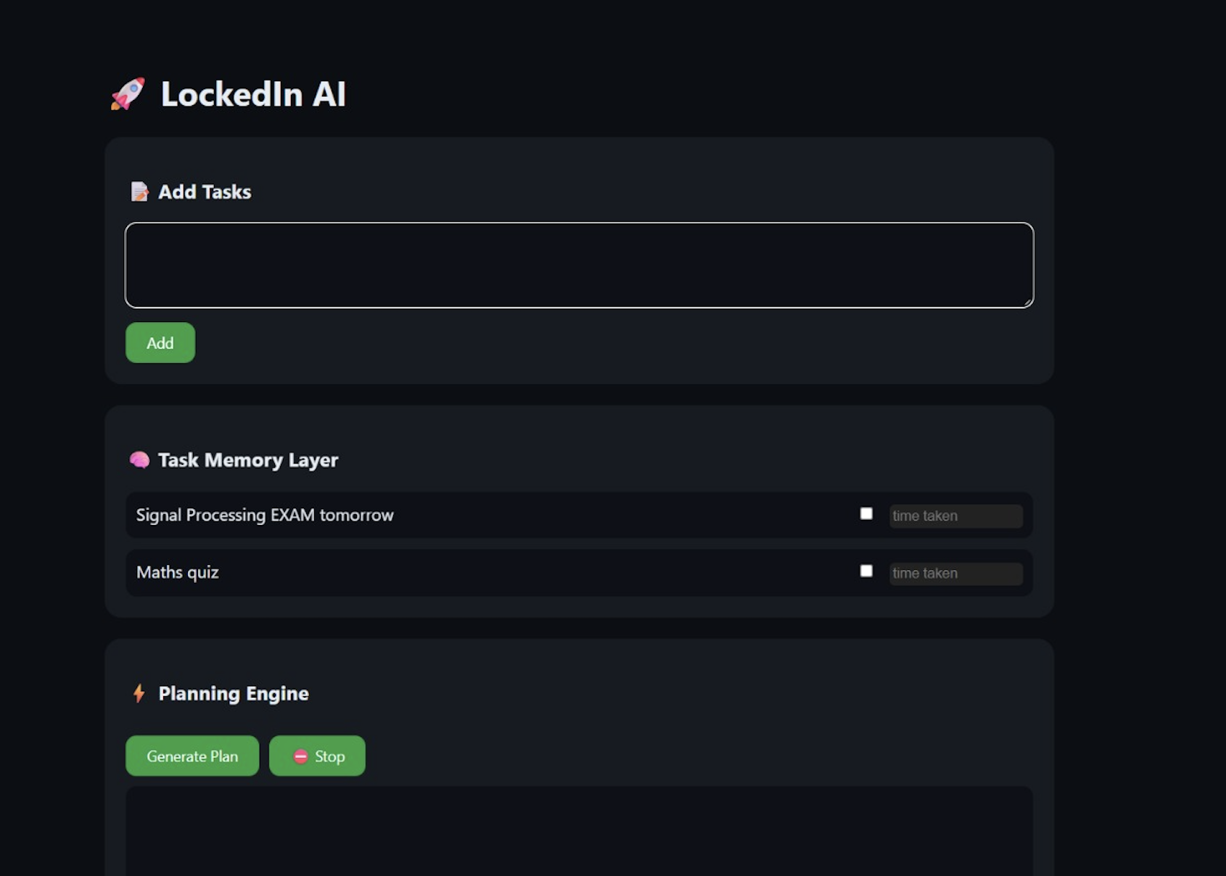
LockedIn AI
Demo/Product Walkthrough
This is LockedIn AI — an intelligent academic productivity assistant designed to help students manage academic workload through adaptive local AI systems.
Students today often struggle with prioritizing exams, managing multiple deadlines, adapting schedules dynamically, and extracting useful information from lengthy academic material.
LockedIn AI addresses these challenges through a modular AI-assisted productivity workflow optimized specifically for students.
Our system is divided into four major intelligent components:
1. Task Memory Layer
2. Planning Engine
3. Interactive Reasoning Module
4. Knowledge Processing Module
We designed a modular AI system inspired by agent-based architectures like OpenClaw, where planning, summarization, and query handling act as independent intelligent components with shared contextual memory.
The system maintains persistent state and contextual memory across tasks, enabling adaptive planning behavior similar to memory modules in agent-based AI architectures.
The Task Memory Layer allows students to dynamically manage and persist academic activities across sessions.
Tasks are stored locally and tracked interactively, enabling continuity and structured academic workflow management.

Slide 6
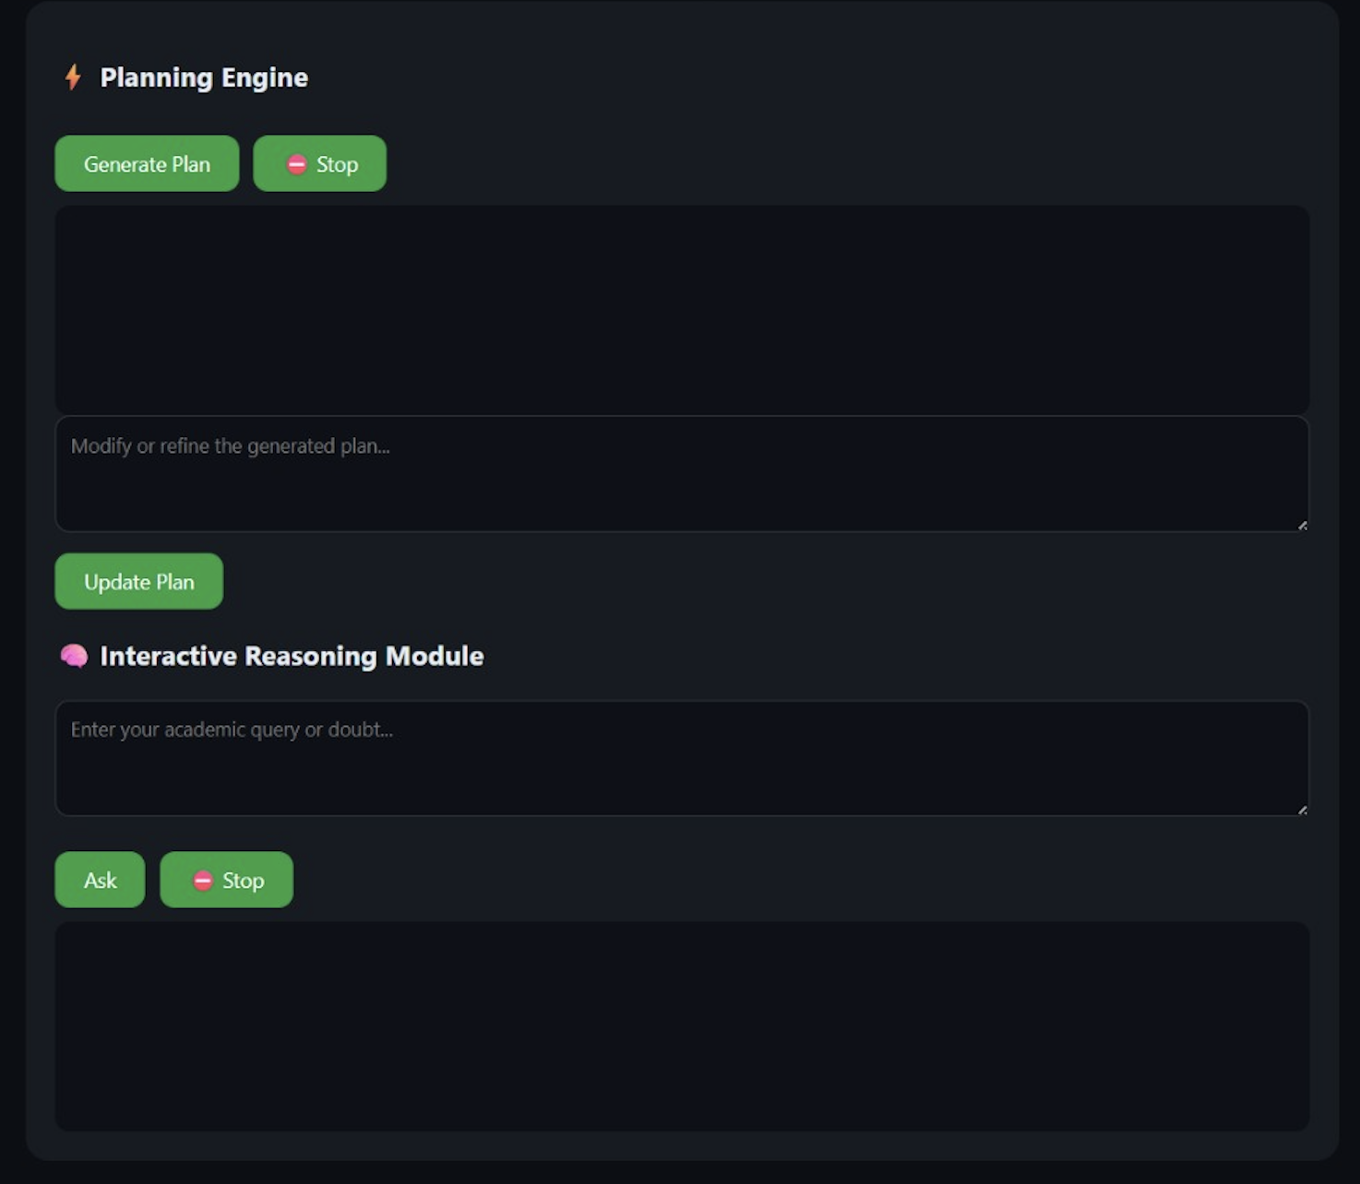
LockedIn AI
Demo/Product Walkthrough
Now moving to the Planning Engine.
The Planning Engine uses local language model inference to generate adaptive academic schedules based on current student priorities.
The system intelligently prioritizes higher-importance academic tasks such as examinations while maintaining concise and structured study plans.
We also optimized prompt constraints extensively to maintain low latency and improve output stability.
We control token generation to ensure low latency and stable outputs.
We also restrict prompt scope aggressively to reduce hallucination behavior and maintain reliable structured responses.
One of the key capabilities of LockedIn AI is adaptive replanning.
Students often face changing academic priorities, and the system dynamically restructures schedules in real time based on updated user constraints and workload requirements.
Now moving to the Interactive Reasoning Module.
The Interactive Reasoning Module enables students to directly interact with the local language model for academic assistance and conceptual clarification.
This provides lightweight educational support while maintaining local inference execution.

Slide 7
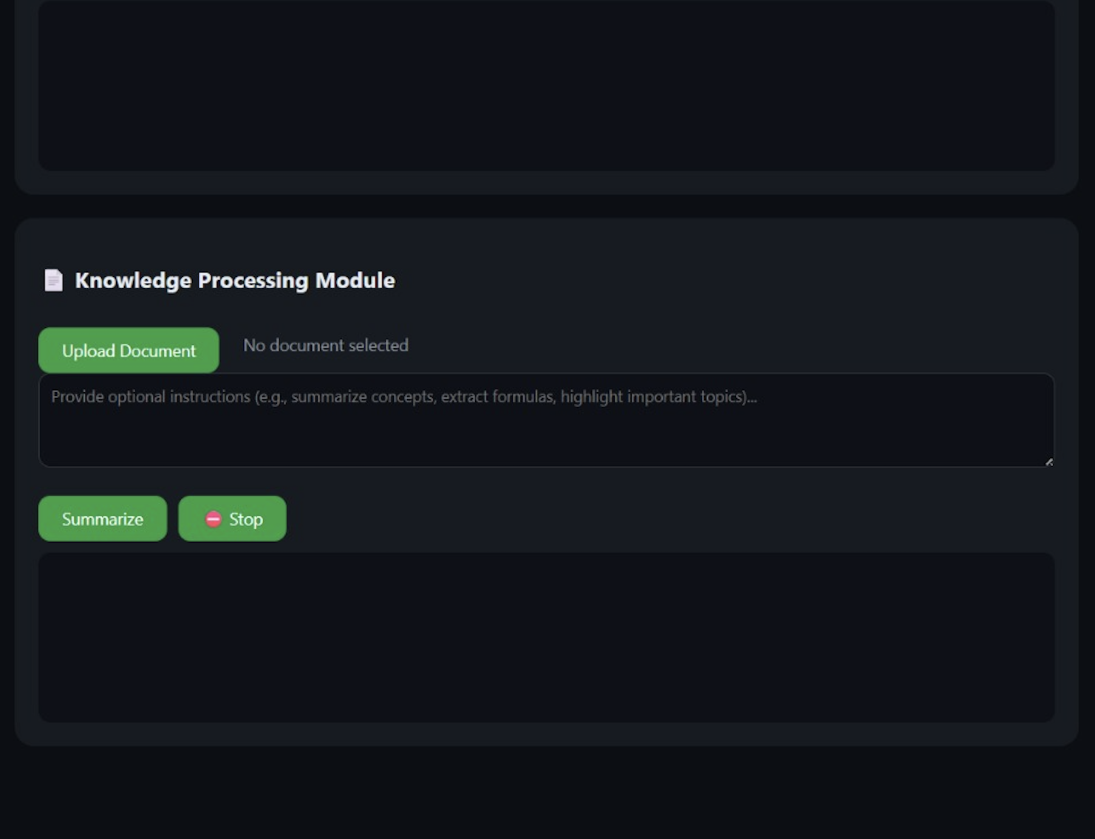
LockedIn AI
Demo/Product Walkthrough
Finally, the Knowledge Processing Module.
Students frequently work with lengthy and information-dense academic material.
The Knowledge Processing Module extracts important concepts and converts large study material into concise revision-oriented summaries for faster learning and review.
Technically, the system combines HTML, CSS, and JavaScript frontend architecture with local AI inference through Ollama and the Qwen2.5 3B language model.
The system also utilizes structured prompt engineering, streamed response handling, and persistent local contextual memory to maintain adaptive workflow behavior.
Future improvements include NPU acceleration, adaptive learning analytics, cloud synchronization, and exam-weightage-based optimization for highly personalized academic scheduling.
LockedIn AI demonstrates how lightweight local AI systems can improve student productivity through adaptive planning, intelligent reasoning, contextual memory, and efficient knowledge processing.

Slide 8
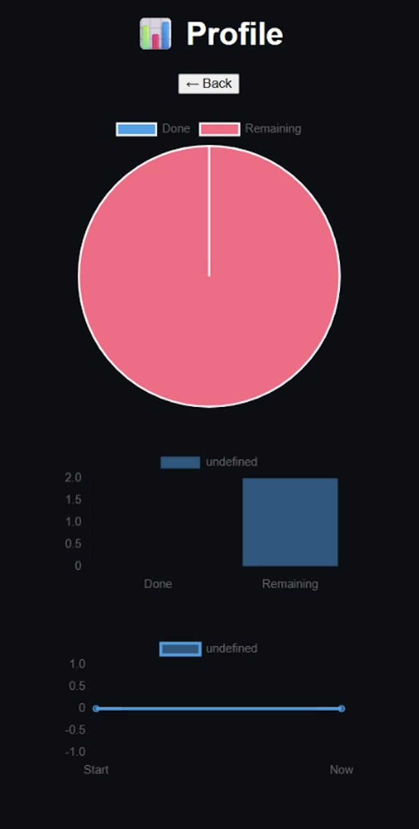
LockedIn AI
Demo/Product Walkthrough

Slide 9
LockedIn AI
Tech & Architecture
Frontend: HTML, CSS, JavaScript
Backend: Node Js
AI: Phi3 mini / Llama (Local Processing, Privacy+speed)
Framework: OpenClaw (planned for agent orchestration and scaling in production)
Interface: Telegram
System flow:
User Interface → API Gateway → Data Persistence Layer → Scheduler & Monitoring Service → Panic Trigger Engine → LLM-Based Planning Module → Task Orchestration Layer → Notification Services (Telegram/WhatsApp) → User Feedback Loop
AI Usage:
Decision-making
Task prioritization
Plan generation

Slide 10
LockedIn AI
Architecture
Inspired by agent-based architectures like OpenClaw, our system separates responsibilities into modular intelligent components with shared contextual memory.
We designed a modular AI system inspired by agent-based architectures like OpenClaw, where planning, summarization, and query handling act as independent components with shared contextual memory.
We control token generation to ensure low latency and stable outputs
We restrict prompt scope to prevent hallucination
Data Flow:
User Input
↓
Planning Engine
↓
Memory Layer
↓
Adaptive Feedback
↓
Output

Slide 11
LockedIn AI
Impact & Use cases
Scenario 1: Last-minute exam prep Scenario 2: Assignment overload Scenario 3: Free time optimization Scenario 4: Daily study planning
Scale Potential:
The system is designed modularly, allowing each component (monitoring, planning, notification) to scale independently as demand grows.
Core services can be decoupled into microservices, enabling horizontal scaling and better fault isolation.
The architecture supports multi-user concurrency with minimal performance degradation due to lightweight processing and async workflows.
LLM usage can be optimized via caching, batching, or model switching to reduce cost at scale.
The platform can evolve from a single-user assistant to an institution-wide system serving thousands of students simultaneously.
Data storage can transition from local JSON to distributed databases for large-scale deployment.
The communication layer (Telegram/WhatsApp) can be extended to web and mobile apps without changing the core logic.
Impact:
Reduces stress
Improves productivity
Helps perform under pressure

Slide 12
LockedIn AI
Differentiation
Why we stand out:
From reminders → decisions → execution: We don’t just track tasks, we decide and act on behalf of the user.
Proactive, not reactive: The system intervenes before the user realizes they’re in trouble.
Time-aware intelligence: Decisions are driven by urgency, not just task lists.
Panic-to-plan transformation: Converts high-pressure situations into structured, executable steps instantly.
Action-first design: Outputs are not suggestions—they are clear, next-step instructions.
Continuously adaptive: Plans evolve in real time based on progress and remaining time.
Contextual prioritization: Focuses on high-impact tasks, not just pending ones.
Zero cognitive load on user: Eliminates decision fatigue during stressful situations.
Always-on monitoring: Works in the background without requiring repeated prompts.
Seamless integration: Fits into platforms students already use (Telegram/WhatsApp).
Lightweight but powerful: Runs without heavy infrastructure while delivering intelligent behavior.
Bridges the execution gap: Solves the biggest problem—knowing what to do next.
Core Technical MOATS:
Urgency Intelligence Engine: Proprietary logic for detecting “panic states” based on time, workload, and progress—not just deadlines.
Real-time adaptive loop: Continuous monitoring + re-planning creates a dynamic system that’s hard to replicate with static tools.
Context-aware prioritization: Goes beyond task lists by understanding impact vs time left.

Slide 13
LockedIn AI
Demo Link
GitHub Repo link - https://github.com/SaileshPusarla/-Ramaiah-Institute-of-Technology-_-LockedIn-AI-/tree/main

